Slide 1
2017 Crime in Cuyahoga county
By: Kristen Blanchard, Jacob servidio, Kimberly gore, Julie Pyle, Matthew Kuhlmann
Notes:
KIM

Slide 2
Summary
Crime rate per population in Cuyahoga County
What city in Cuyahoga County holds the highest total crime?
Crime in Cleveland, Ohio
Effects of age
Effects of race
Data:
2 API Keys
CSV file
Notes:
KIM – 30 sec
Crime rate per population in Cuyahoga County
Population appears to be a factor in crime rates across the County
What city in Cuyahoga County holds the highest total crime?
Cleveland
We focused on Cleveland when looking at age and race because Cleveland has the highest totals
Effects of age
Varied based on the type of crime committed
Effects of race
Varies based on the type of crime committed
API Keys
FBI key for additional crime data
Gmaps Key for heat maps

Slide 3


Questions and data
Crime rate per population in Cuyahoga County
Office of Criminal Justice Services Website for Ohio
What city in Cuyahoga County holds the highest total crime?
Effects of age on crime
Effects of race on crime
FBI API Key
Found on: api.usa.gov/crime/fbi
https://crime-data-explorer.fr.cloud.gov/api
https://www.ocjs.ohio.gov/#gsc.tab=0
Notes:
JACOB - 1 min
Crime rate per population in Cuyahoga County
Converted excel file into a CSV file for OCJS website
Did not have totals for each city but only counties, so we had to do create our own totals column within the CSV file
Added latitudes and longitudes to generate a heat map to show the crime rate
What city in Cuyahoga County holds the highest total crime?
Age: Cleveland
Race: Cleveland
Each of these totals did not take population into consideration
FBI API Key
Played around with the API key to determine what kind of data we could find that held similar/corresponding information to the CSV file

Slide 4
Data cleanup and Exploration
FBI Key
Exploration on website
Race and age breakdown
Append race into its own data frame
Append age into its own data frame
CSV File
Read in the file and turned all the ”NaN” into ”0”
Dropped rows: population == 0
Notes:
JULIE: CSV – 1 min
JACOB: API – 2 min
Show Jupyter Notebook for CSV file
Someone different prepare to share FBI example of appending either age or race and explain how we did the same thing for the other (don’t show) this needs to be fast\
WE will say what is on this slide while showing jupyter notebook

Slide 5
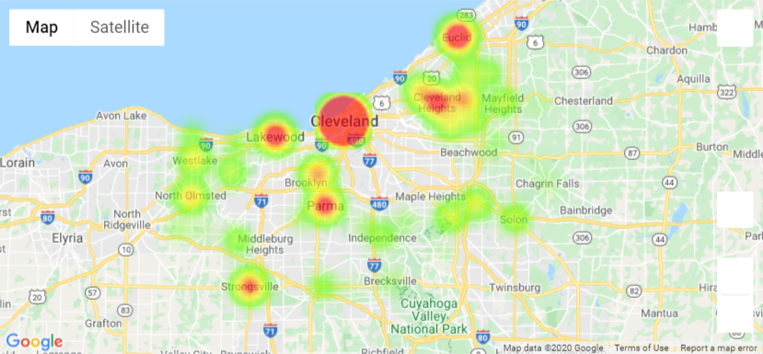
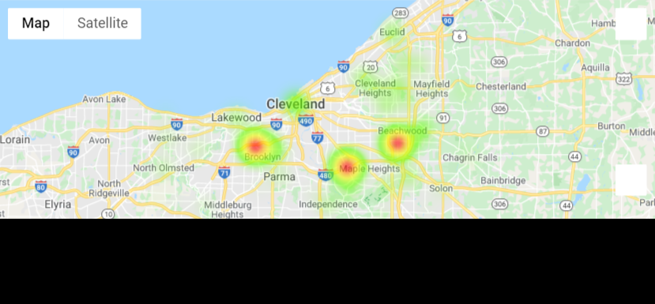
Data analysis – Crime Rate per population in Cuyahoga County
Crime rate not accounting for population.
Crime rate per population.
Notes:
KRISTEN – 1 min
When population was left out of consideration, Cleveland was the hotspot for crime but when we took population into consideration Cleveland was on the lower end of the crime rates
Crime rate per population in Cuyahoga County
Created totals column for crime per city in Cuyahoga county
Determined the rate
Made a heat map to show the gradient across Cuyahoga County

Slide 6
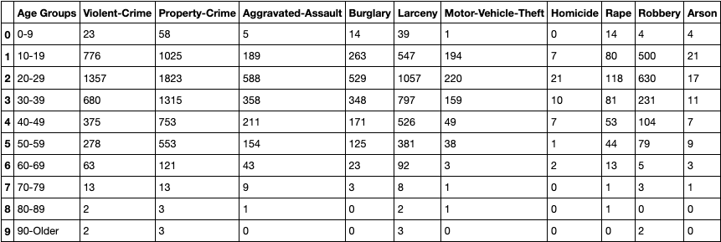
Data analysis – effects of age on crime In Cleveland
Property crime was the highest type of crime in Cleveland for every age group
Age range of 20-29 in general has the largest overall offenses per crime type
Notes:
MATT – 30 sec
Data shows the types of offenses per age
Broke down age by 10 years
Within Jupyter notebook we created bar charts that gave visual representations of this data

Slide 7
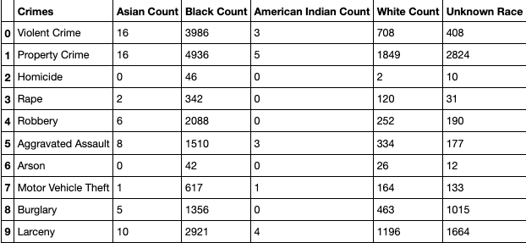
Data analysis – effects of Race on crime In Cleveland
The Black race had the largest offenses per crime
Property Crime has the most offenses within each race
Notes:
MATT – 30 sec
Data shows type of offenses per race
Within Jupyter notebook we created bar charts that gave visual representations of this data

Slide 8
Discussion
What we found:
Cleveland would have the highest crime rate across the county
Property crime would have the highest offenses compared to the other types of crime
Crime results across the age groups
Conclude:
Population
Ages
Race
Notes:
KRISTEN – 40 sec
Cleveland highest crime rate across the county
unexpected when taking poplar into consideration the crime rate of Cleveland significantly dropped
Crime across the age groups
shocking that 0-9 year old's had many offenses especially within the rape category
JULIE – 40 sec
Population:
population seems to be a large factor when determining the rate of crime within a city
Ages:
20-29 Year old's tend to commit the most amount of crimes
Race:
The black race appears to commit the most amount of crime

Slide 9
Post Mortem
Limitations
Race
Accessible data
Dropped rows for population == 0
Future Directions
Break down race and age data for all reporting agencies within the county
Distance from Cleveland
East side versus west side
Additional Questions
Effects per season
Effects based on weather
Notes:
KIM - left
Limitations
Race: black race was combined African American and black when the race does differ especially when it comes to statistics
Data:
lack of access to data 2018 and after
data in general was limited without buying access – created questions based off the data we had
took a while to get usable data
Population: Took away data but was only Metroparks and college Agency's that were dropped
Additional Questions:
effects per season: broken down by months for crime rate
effects based on weather: are there any large or impactful weather changes that show a spike in crime
Future directions
distance from Cleveland: is there a pattern based on the direction and/distance you move away from Cleveland – east side versus west side

Slide 10

Questions?

